Slide 1
Comprehensive Cross-Domain Enterprise Threat Exposure Analysis
Greg Conti
Bob Fanelli

Slide 2
The views expressed in this talk are those of the authors and do not reflect the official policy or position of Kopidion, the United States Government, or any of our other current or past employers.

Slide 3



Greg Conti
Principal, Kopidion
@cyberbgone
Bob Fanelli
Principal, Kopidion

Slide 4

He’s intelligent,
but not experienced. His pattern indicates two dimensional thinking.
He followed me this far. He’ll be back. But from where?
https://www.youtube.com/watch?v=iPQfwmfRq2s

Slide 5
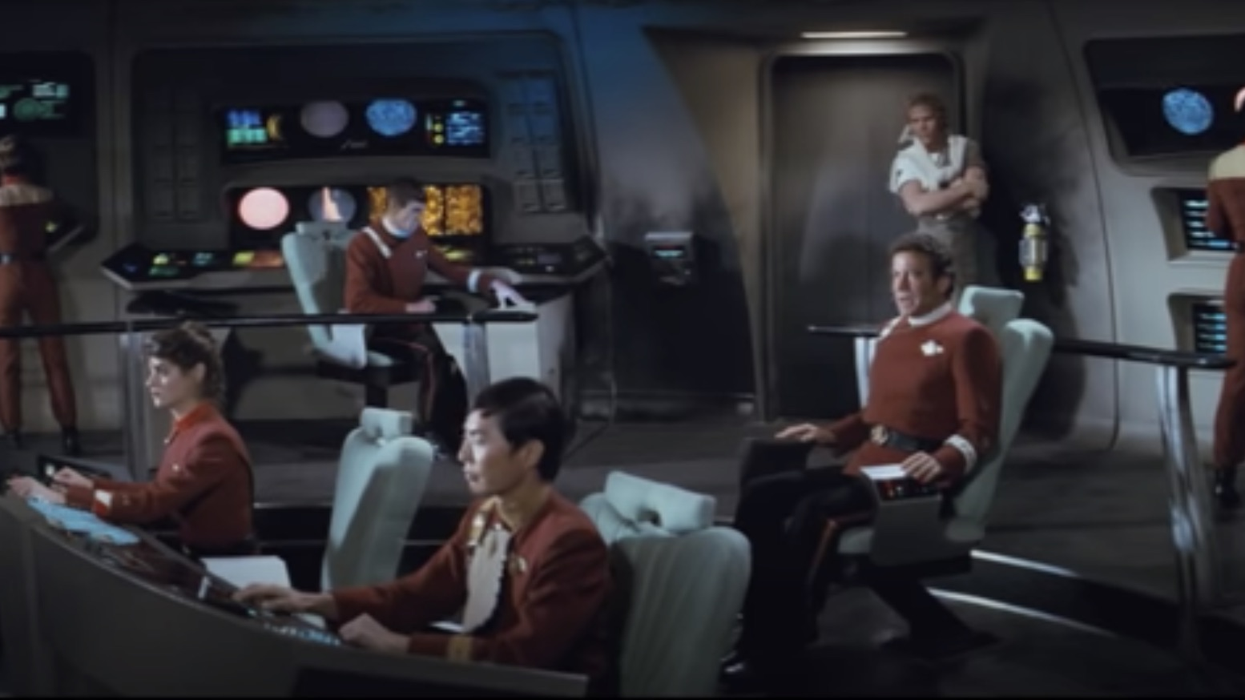
Z-10,000 meters…
Standby photo torpedoes

Slide 6
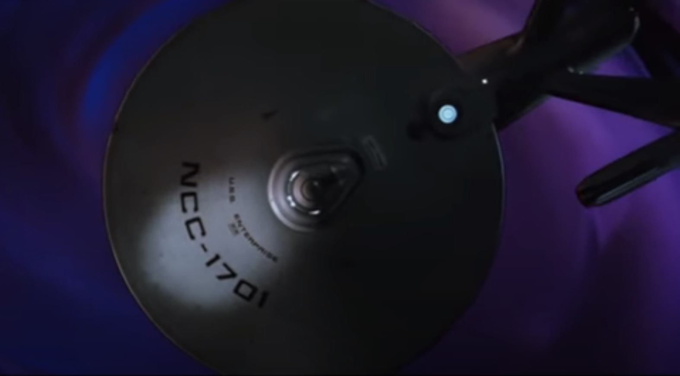

Slide 7
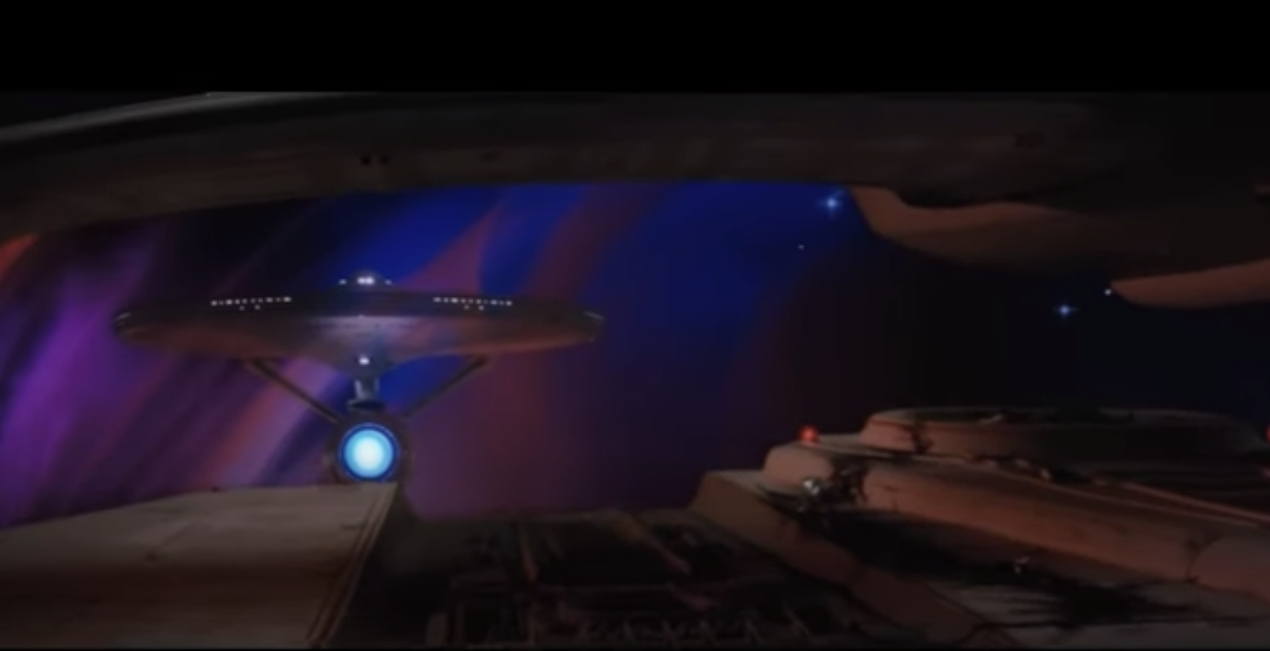
FIRE!

Slide 8
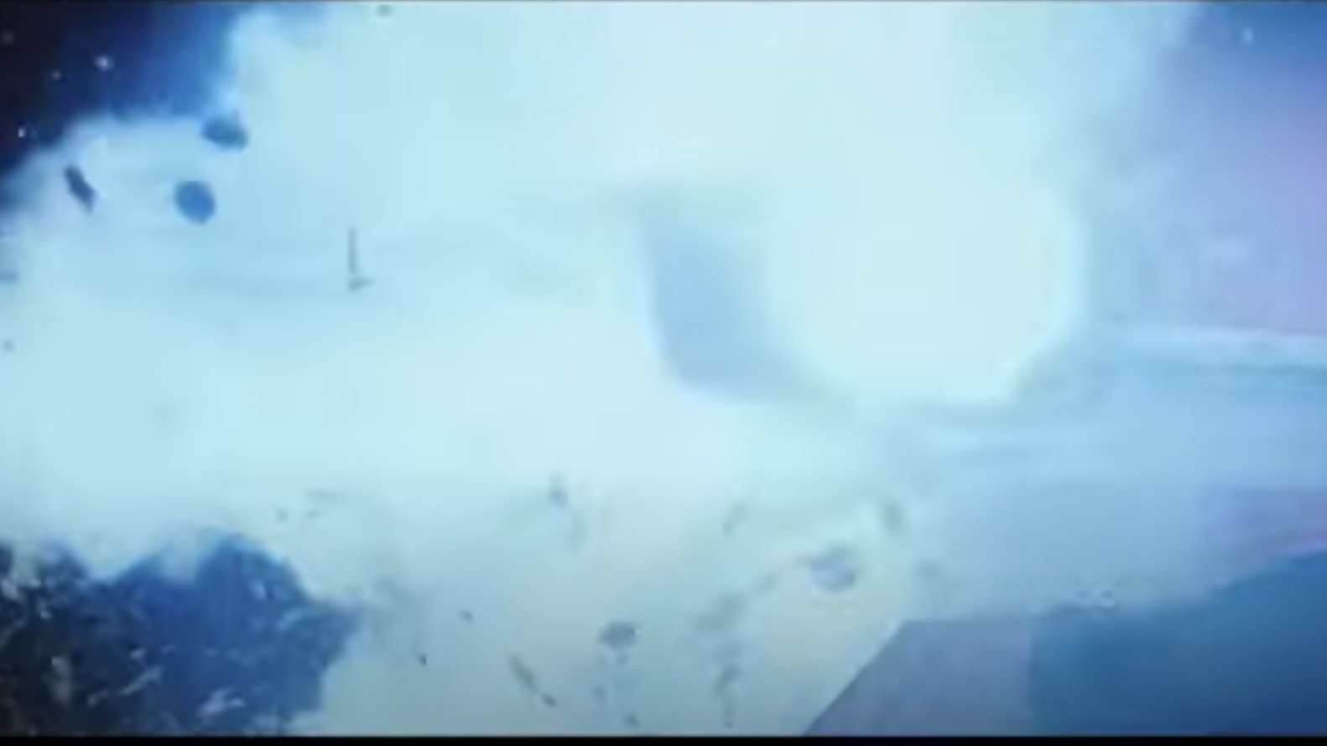

Slide 9
Problem
Defenders fail to consider the entire projection of their organization in virtual and physical space.
Attackers understand this and find un(der)-protected areas, often at gaps and seams to exploit.
Is it possible to create a framework that enables repeatable holistic analysis?
Imagine your organization’s projection
into cyberspace and physical space.
https://thegraphicsfairy.com/unusual-shadow-puppet-printable/

Slide 10
Why, So What, Who Cares?
There are literally armies operating in cyberspace.
Current attack surface analysis is a good start, but insufficient.
All enterprise defenders (including red teamers) can benefit from a framework that supports comprehensive multi-domain analysis
Analysis assists in prioritized allocation of scarce security resources.
https://hearinghealthmatters.org/wp-content/uploads/sites/16/files/2020/08/whisper.jpg

Slide 11
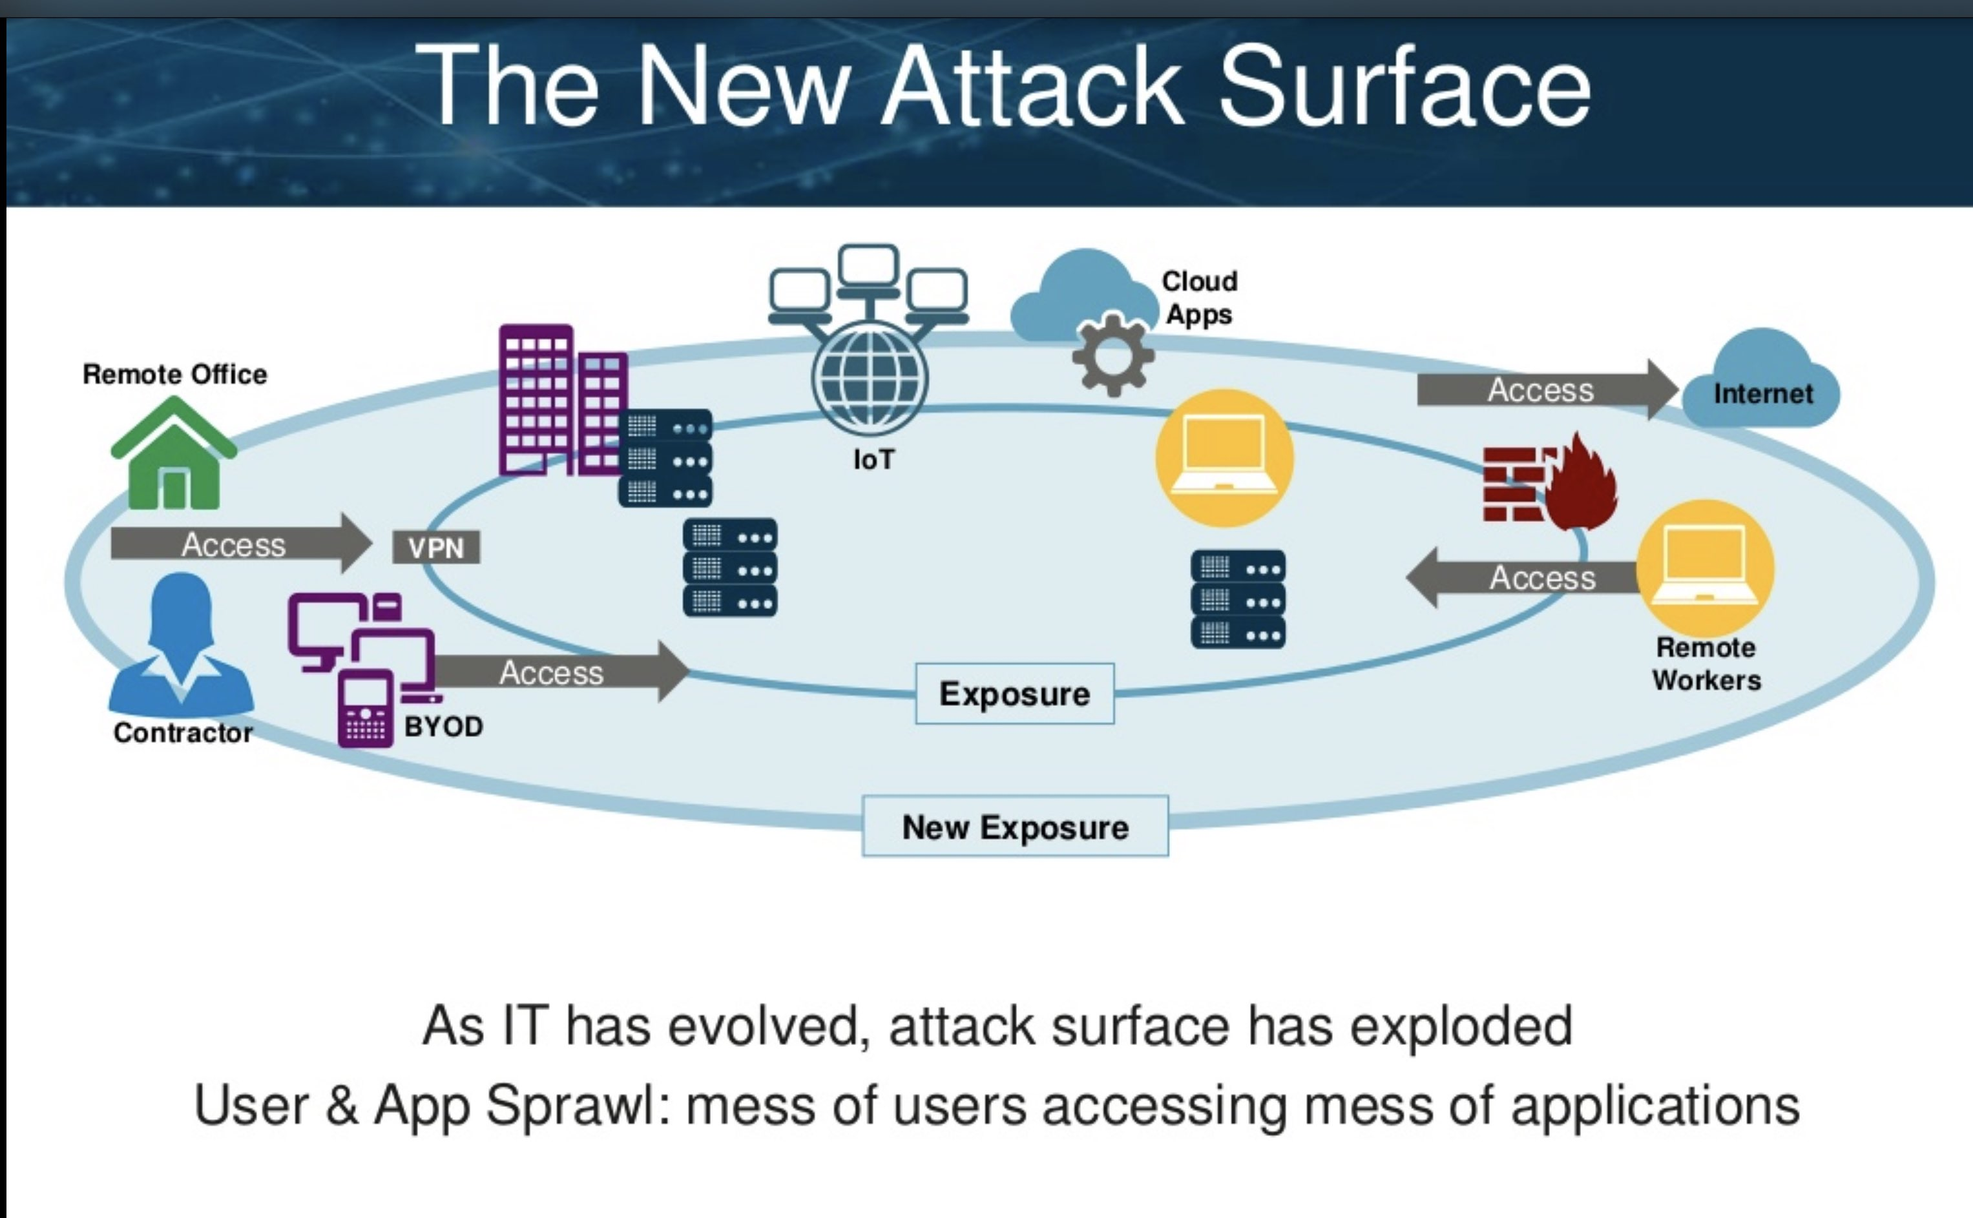
Related Work
Intellyx/Certes Networks, “The Cyber House of Horrors: Securing the Expanding Enterprise Attack Surface,” Webinar, 2016 Slides
RiskIQ, “Analysis of an Attack Surface,” White Paper, 2020 Link

Slide 12
Linkages
Attacker TTPs/Methodologies
MITRE Pre-ATT&CK framework
MITRE ATT&CK framework
Side Channel Attacks
Business Best Practices
Business Continuity Planning (BCP)
Disaster Recovery (DR)
Risk Analysis
Interdependency Analysis
Physical Security
Enterprise Threat Exposure Analysis
Defensive Planning
Threat modeling
Attack graphs
Black Swan Events
IT/InfoSec Best Practices
CIS Top 20 (#1 & #2)
Configuration Management Databases (CMDB)
Common Vulnerabilities and Exposures (CVE)
Collective Defense
OSI Model
Data Leak Prevention (DLP)
Visibility Analysis
Military
Multi-Domain Operations
Effects-Based Operations
Mission Assurance
Center of Gravity Analysis
OPSEC
TEMPEST

Slide 13
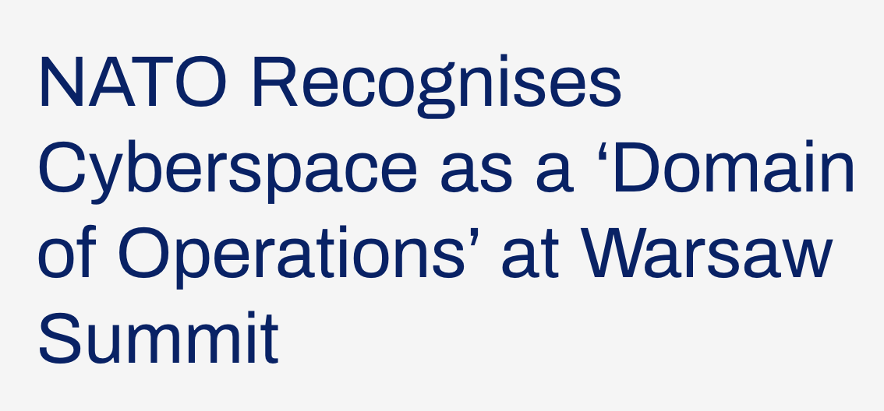

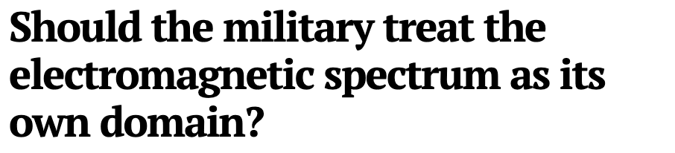
Operational Domains
EM Spectrum
Cyberspace
Space
Air
Land
Sea
https://ccdcoe.org/incyder-articles/nato-recognises-cyberspace-as-a-domain-of-operations-at-warsaw-summit/
https://www.defensenews.com/electronic-warfare/2019/11/06/should-the-military-treat-the-electromagnetic-spectrum-as-its-own-domain/

Slide 15
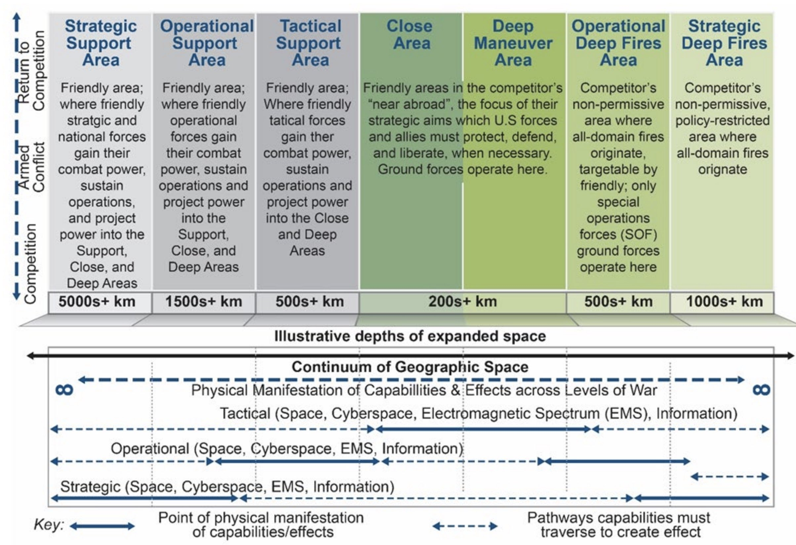

Slide 16
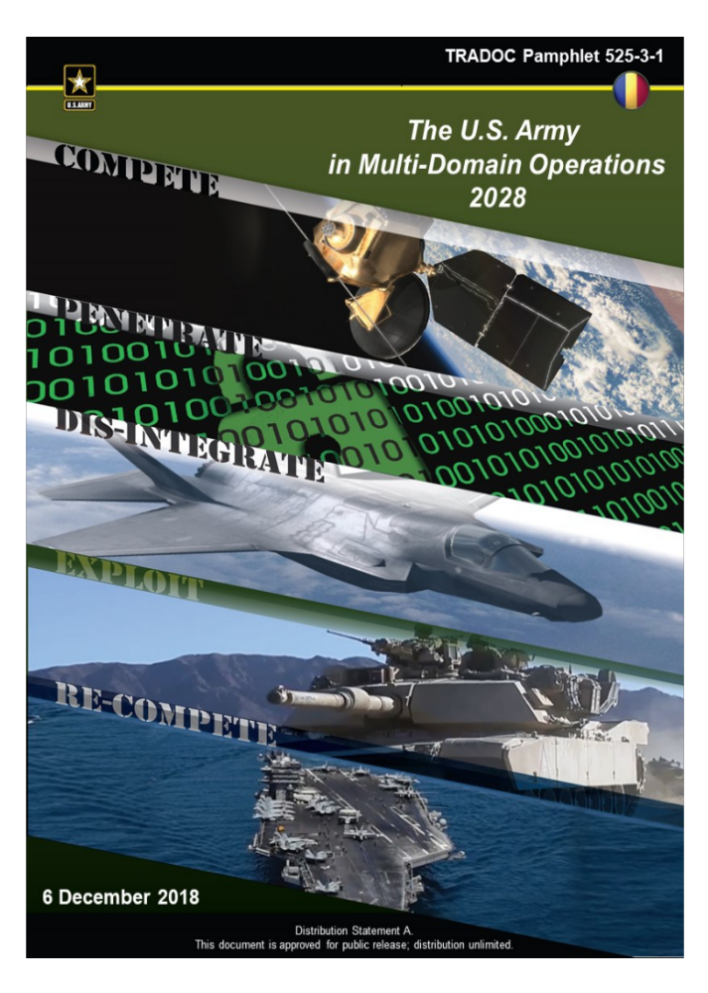
https://www.tradoc.army.mil/Portals/14/Documents/MDO/TP525-3-1_30Nov2018.pdf

Slide 17
What Happens When You Fail to Consider a Dimension?
+
=

Slide 18
Attacker bypasses
physical security perimeter through cyberspace attack
Cyberspace
A
Network Security Perimeter
B
Attacker bypasses network security perimeter through malicious thumb drive
in parking lot.
Organization
Parking Lot
Physical Security Perimeter
Physical World

Slide 19
What is Your Organization’s Footprint?
https://file.org.br/artist/joon-y-moon/

Slide 20
Nodes
Nodes store and process information and interact with other nodes via links.
Examples include: humans, computing systems, social media personas, social media personas
Can generate effects on other nodes and links.
For convenience we can aggregate as necessary, and exist on multiple planes.
Node: Nodes are informational or physical entities.

Slide 21
Call of Duty
HR System
Government Database
Credit Card Processing
https://aws.amazon.com/blogs/publicsector/tag/data-center/

Slide 22
Links
Links may connect nodes on the same plane or between planes.
  Same plane: TCP/IP networking, human-to-human interaction
  Different plane: human-to-machine interface, IT/OT
Links often comply to protocols (LTE, 802.11, Ethernet, APIs…), except when they don’t.
Can be bidirectional or unidirectional
Links enable propagation of desired and undesired effects
Link: Line of communication or influence between two nodes.

Slide 24

















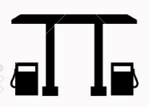
Humans
Human-Computer
Interface
Persona
Virtual
Physical
IT/OT
Interface
Geographic

Slide 26
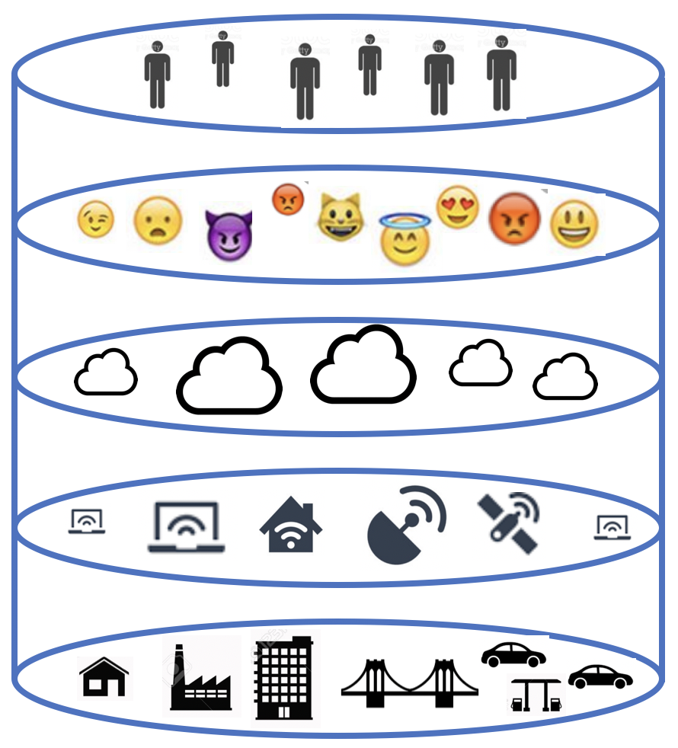

Slide 27
https://commons.wikimedia.org/wiki/File:Internet_map_1024.jpg

Slide 28
Scoping and Coping with Complexity

Slide 29
Degree of Control We Have Over Links and Nodes
Things You Can “Touch”
Other Things
That Can
Affect You and
You Have
No Control
Things You
Can Control
Things Where
You Have
Shared Control
Things Where
You Have
Responsibility and
Not Control
Everything
Else

Slide 30
Things You
Can Control
Shared
Control
No Control, But Can Cause Effects
Things You Can Touch
Shared
Control
Responsibility
Without Control

Slide 31
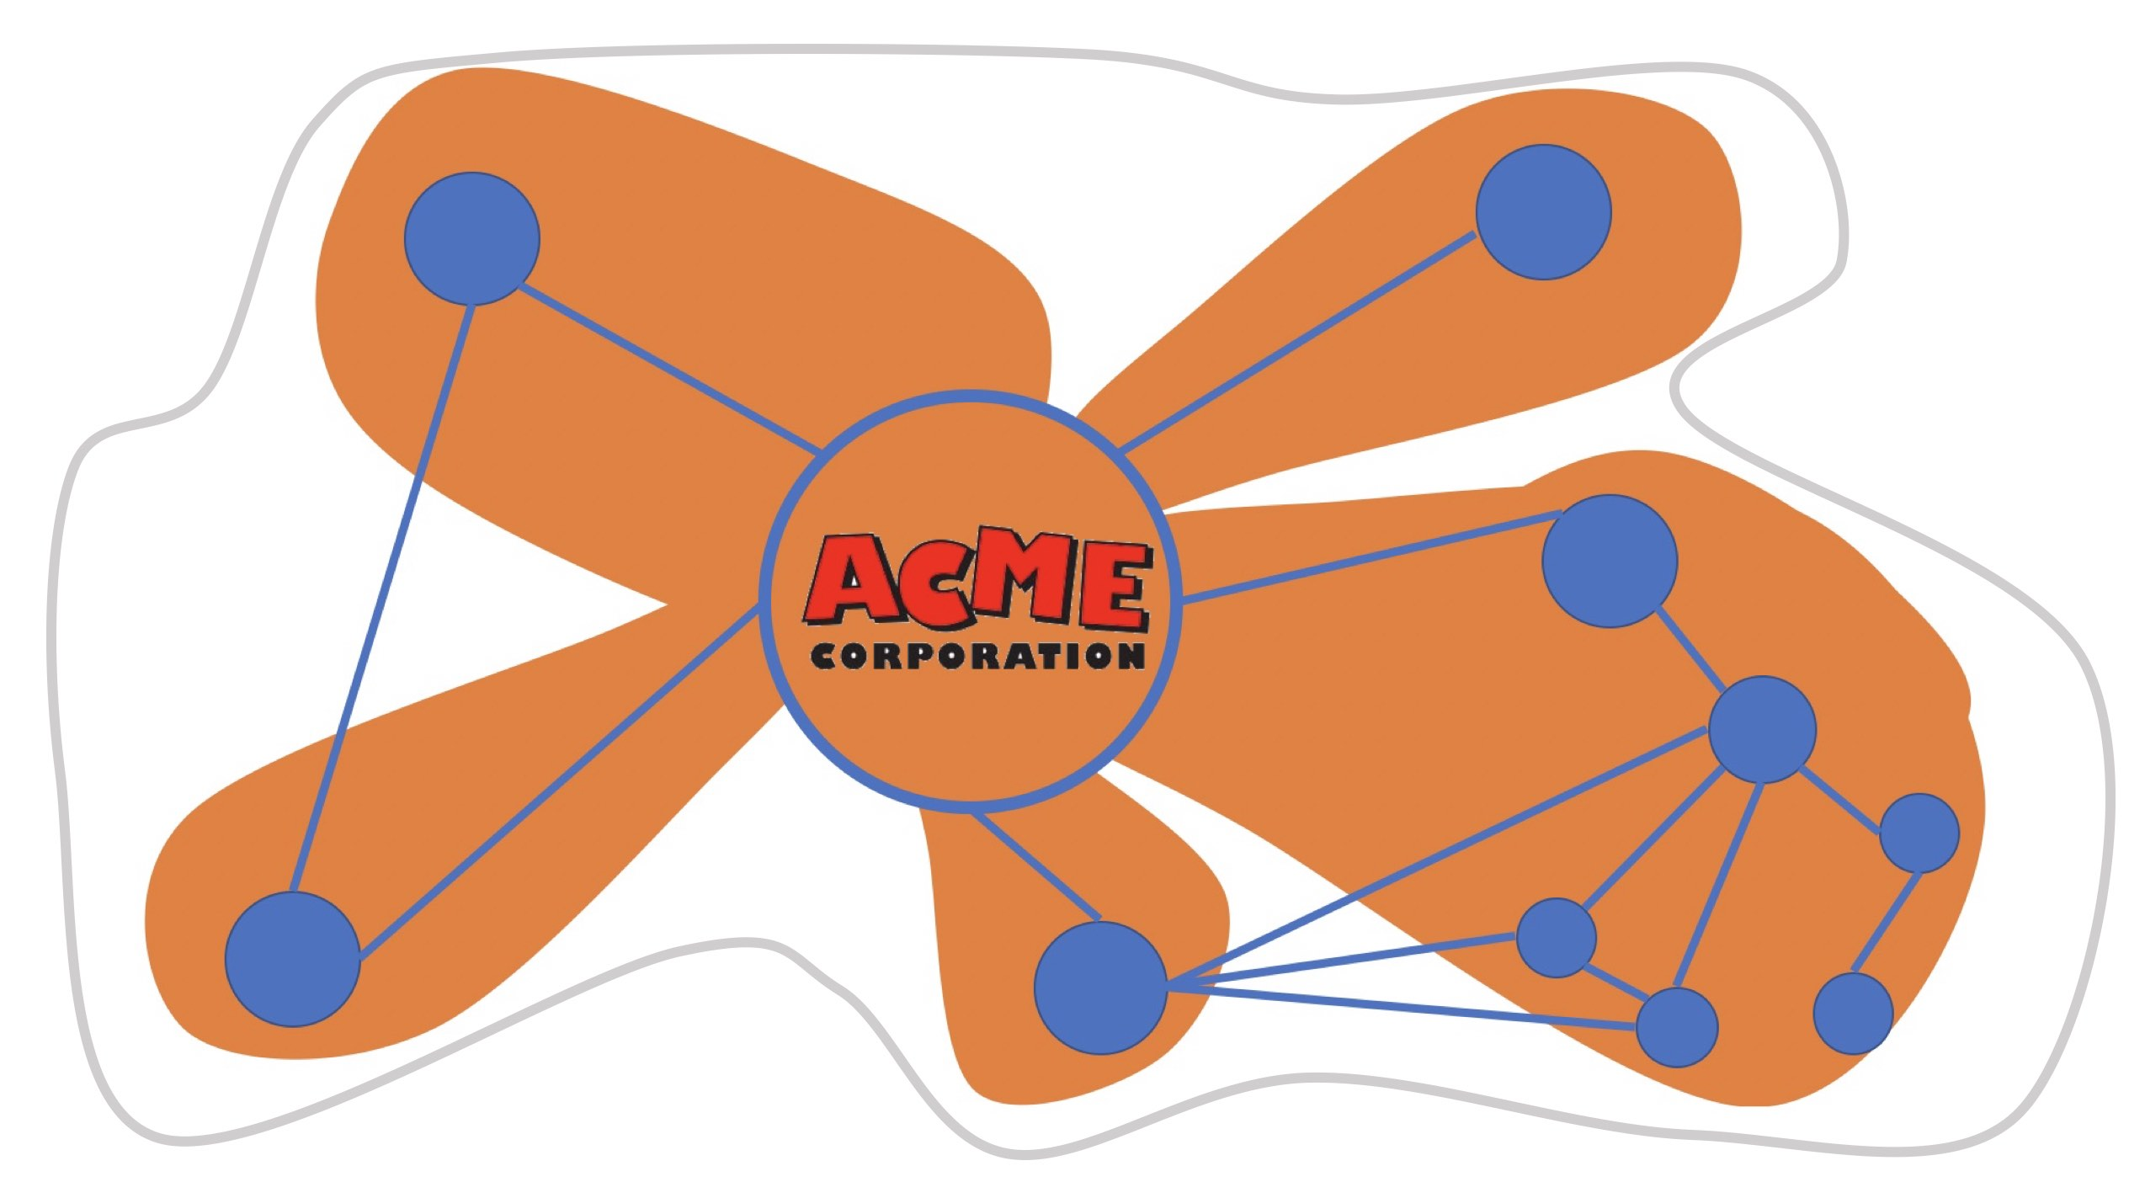
V
Vulnerability
D
Dependency
C
Capability or
Exploit
E
V
Attack
V
D
Attack Surface
V
Footprint
E

Slide 32
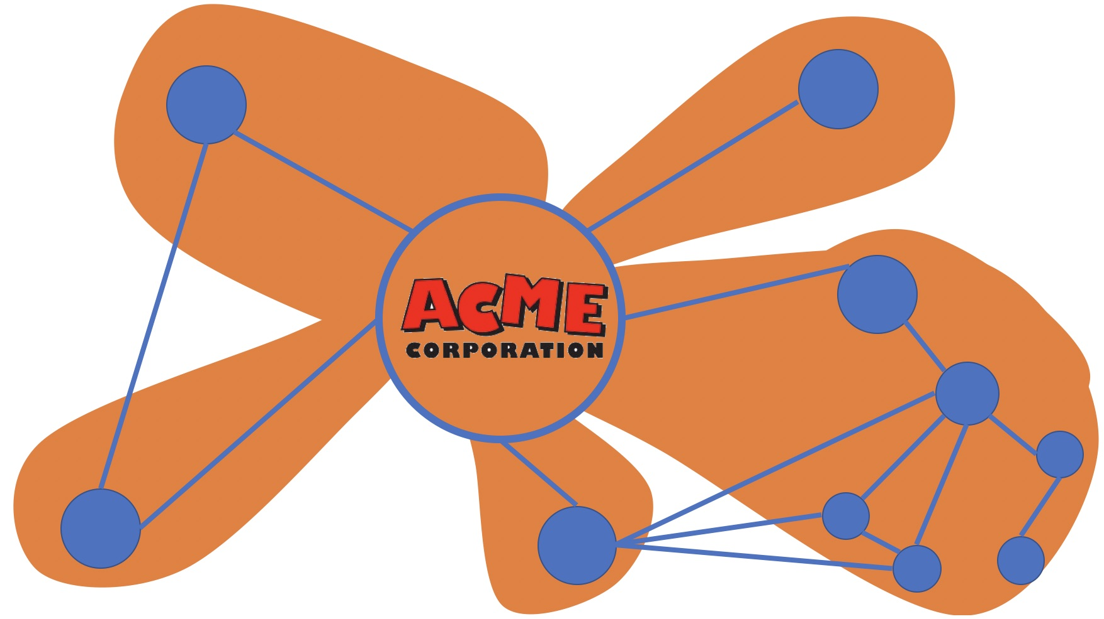
Indirect Attack
Direct Attack
V
Effects
V
D
Effects
V
V
V
Effects
V
D
Effects
Indirect Attack
D

Slide 33
Special Cases
Attacker
“Blind” Attacks
Information Leakage
& Side Channels
Dependency

Slide 34
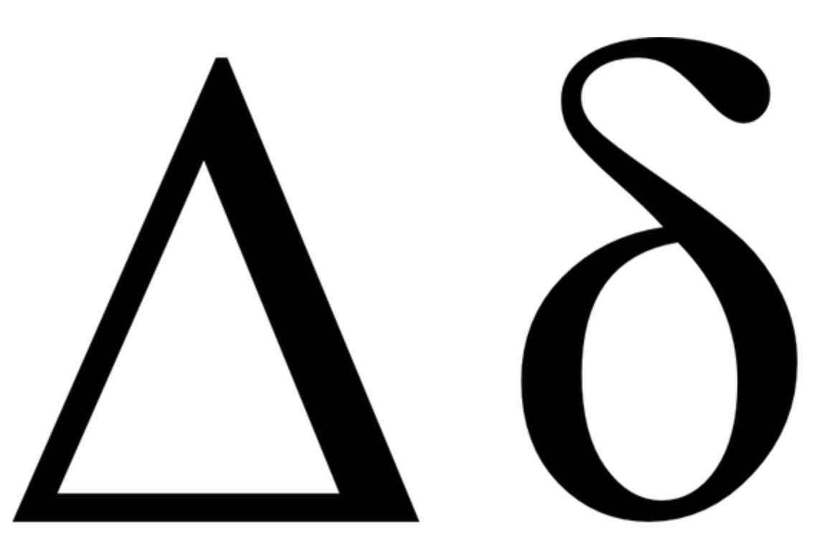
Virtual and Physical Changes over time
Big Changes
Mergers and Acquisitions
Organization shifts to work from home due to COVID
Moving from data center to a cloud architecture
OS upgrade to an end point fleet
Sub-contracting a major project
Continuous movement of workforce’s cell phones and laptops
Small Changes
Patching an endpoint
Employee comes home and continues work in home office
Configuring firewall for new 3rd party service
Employee goes to a conference
Cosmic rays flip a bit

Slide 35
Attacker
What Can Be Seen
What Can Be Reached
What is Vulnerable
What is Exploitable
Effects Desired
Work Factor
Value
Risk
ROI
X
Pause

Slide 36
 | “Touch” | Control | Shared Control | Responsibility, Not Control | Other Things That Can Affect You
Human | Onsite Workforce | Distributed workforce | Contractors | 3rd Party vendors | Family members
Persona | Organizational user accounts | Cloud service accounts | Company social media presence | Company officer social media presence | Influencers, Fraudulent personas
Virtual | On-premises OS and software images | Enterprise cryptographic keys | Cloud services, VPC | 3rd Party software updates, Registrar and DNS records, Offsite storage | OS and cloud vulnerabilities, Cryptographic flaws
Physical (Infrastructure) | Data center, On-premises hardware | Remote employee devices, Leased data center | Shared data center/CoLo, Facility OT | BYOD, Rogue hardware, Cloud provider hardware | Network service providers, Undersea cables
Physical (Environmental) | Onsite wireless, Facility HVAC | EM emissions, TEMPEST controls | Licensed EM spectrum, Fire prevention | EM leakage, Audio emanations, Seasonal climate | EM interference, Power failure, Natural disaster
Geographic | Physical locks and keys | Office building security | Shared office building security | Parking lot | Vehicular traffic

Slide 37
Visibility Analysis and Coordinated
Cyber Threat Intelligence
Place organic (OS) sensor/controls on potential attack vectors across planes
Use collective defense strategies to place or gain access to external sensors (ES) in blind spots
Consider inter-organizational threat intelligence collection and sharing
Prioritize resources to prioritize most dangerous and most likely attack vectors.
E
O
O
O
O
O
E
O
Organic/Internal Monitoring
E
External/Shared Monitoring

Slide 38
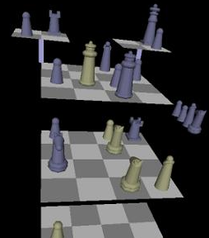
Conclusions and Key Takeaways
Work to understand the complete footprint of your organization
Extend your enterprise attack surface analysis…
  Vertically (across the layers)
  Horizontally (beyond the enterprise perimeter)
Use results to…
  Inform organizational risk management
  Focus threat intelligence collection
  Architect more defensible systems
  Improve placement of security controls
The methodology is also useful for cities, critical infrastructure sectors, nations, and corporate ecosystems

Slide 39
Where to Go for...
More Information
Greg Conti and Bob Fanelli, Operational Templates for State-Level Attack and Collective Defense of Countries, Black Hat USA, 2019.
Greg Conti and Bob Fanelli, Dim Mak: A Study of the Pressure Points that Could Take Down Cyberspace, BSides Long Island, 2019.
Greg Conti and David Raymond, On Cyber: Towards and Operational Art for Cyberspace Operations,” 2016.
Black Hat Training: Military Strategy and Tactics for Cybersecurity and Information Operations courses
RiskIQ
Future Work
Consider things like attack graphs and complex systems analysis.
N dimensional spaces and vectors, graph theory
Automated attack surface generation (from attacker and defender perspectives)
Linking attack surface models with defensive and offensive models
Software Defined Perimeters

Slide 40
Questions???
Greg Conti
Principal, Kopidion
@cyberbgone
Bob Fanelli
Principal, Kopidion
Kopidion.com

